Slide 1
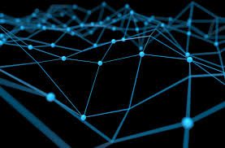
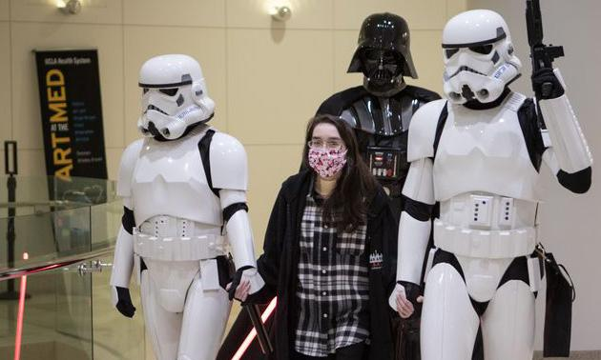
Covid-Resnet
Fighting covid19 using Deep Learning
covid-19
Nadeem Shaikh-180020099
Rishab Khantwal-180100095
DL
Doctors
Presentation video -https://drive.google.com/drive/folders/14wkuA6HDd197V8PBU9DAyFTBoimp7lh3?usp=sharing

Slide 2

Timeline
Phase 1 (Beginning):
Paper review
Preprocessing
Phase 2(Soul):
Model Construction
Phase 3(Final touch):
PPT+Video+Repository

Slide 3
Covid-net
This work was an attempt to produce open source work in Deep Learning related to COVID-19
This paper presents a dataset which was the largest open source chest X-ray image dataset.
This paper also introduces a Deep Learning model that can classify the chest x-ray images of Covid-affected, Normal, Pneumonia patients.
https://arxiv.org/abs/2003.09871

Slide 4
COVID-RESNET
A Deep Learning Framework for Screening of COVID19 from Radiographs
By: Muhammad Farooq1 and Abdul Hafeez2
The Paper focuses on:
1) Improve the overall accuracy of the model for all the four classes with positive predictive values > 90 (among all classes).
2) Use network architecture with lower number of parameters and computational needs. An architecture that provide a balance between performance and computational complexity.
3) Use techniques for training models which need a lower number of epochs and hence faster training.
https://arxiv.org/pdf/2003.14395.pdf

Slide 5
Why we Chose this paper
It proposes Modern ML techniques to improve the accuracy
At the time of Project the Dataset size has increased a lot, it means there are now more data to train and evaluate the method
It brings New concepts of Cyclical learning rate and Three stage training which looks promising
We get to train on the largest public dataset on covid-19 images

Slide 6
3 stage training in 50 epochs
Stage - I:
The input images are resized to 128x128x3 pixels and
the COVID-ResNet are tuned in 2 steps.
Only the newly added head of the network is trained while preserving the ImageNet weights for the rest of the body with a learning rate of 1e-3 for 3 epochs.
The whole network is fine-tuned (both the body and the head of the model) for 5 epochs.
Stage - II: The head of the model resulting from stage-I is
further fine-tuned with images of size 224x224x3 in the first
step with learning rate of 1e-4 for 3 epochs.
Stage - III: In the last stage, the whole network is further fine tuned with input images of size 229x229x3 for 25 epochs. In
this case we use discriminative learning rates where the earliest
layer was trained with a learning rate of 1e-6 and the last layer
was trained with a learning rate of 1e-4. All the layers in
between were trained with equidistance learning rates between
these two values.

Slide 7
Stage - II:
The head of the model resulting from stage-I is
further fine-tuned with images of size 224x224x3 in the first step with learning rate of 1e-4 for 3 epochs.
In the second step, the whole network is further fine-tuned for 5 epochs

Slide 8

Stage - III:
The whole network is fine tuned with images of size 229x229x3
The learning used in this stage is 1e-6
The top layers are fine tuned for 25 epochs

Slide 9
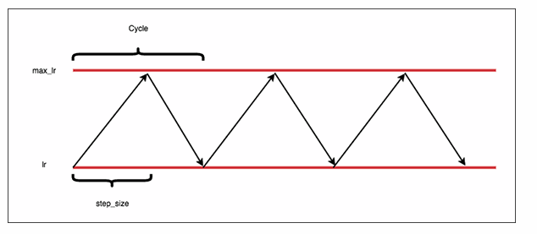
Cyclical Learning Rate
Problems with a monotonically decreasing learning rate:
First, our model and optimizer are still sensitive to our initial choice in learning rate.
Second, we don’t know what the initial learning rate should be — we may need to perform 10s to 100s of experiments just to find our initial learning rate.
Finally, there is no guarantee that our model will descend into areas of low loss when lowering the learning rate.
Credits:https://www.pyimagesearch.com/2019/07/29/cyclical-learning-rates-with-keras-and-deep-learning/
https://arxiv.org/abs/1506.01186

Slide 10
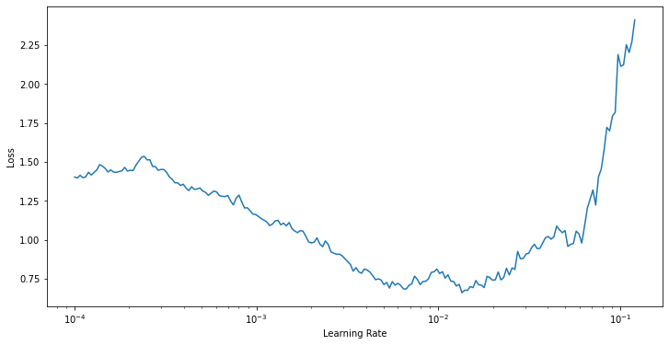
Running CLR on our model
As you can see from the graph Minimas are around 0.01 so we picked LR=0.01 for stage 1 and as going further we decreased it to 10⁻³ and then 10⁻⁴ in the later stages

Slide 11
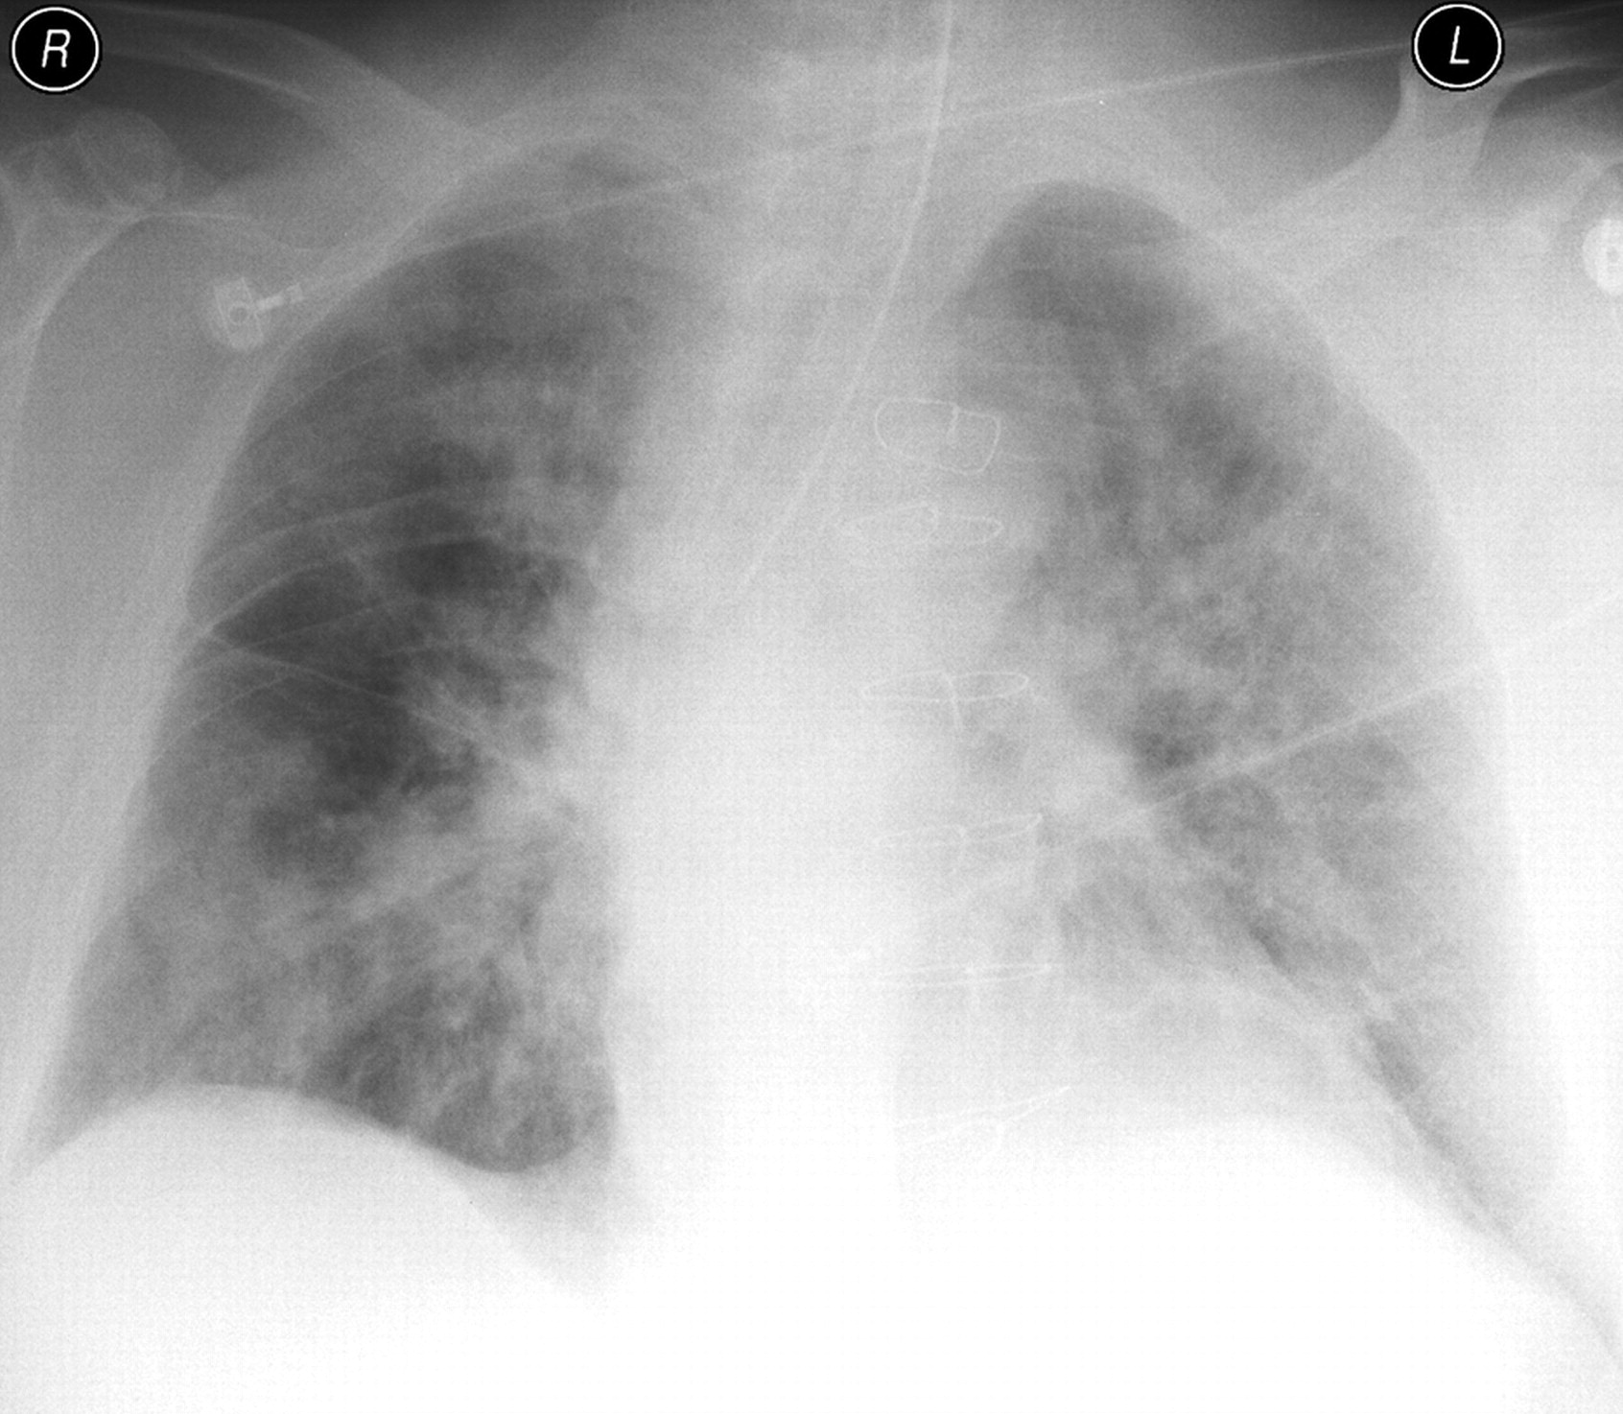
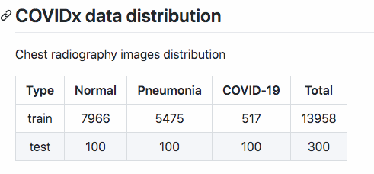
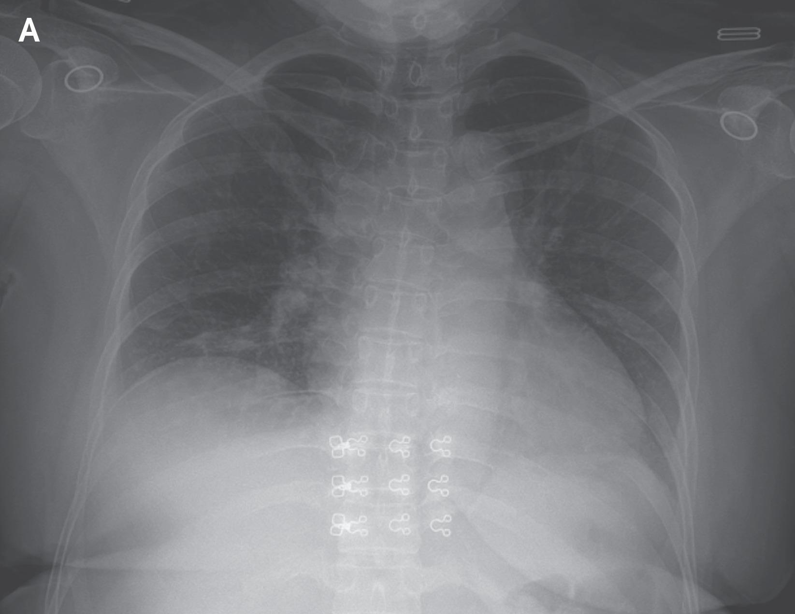
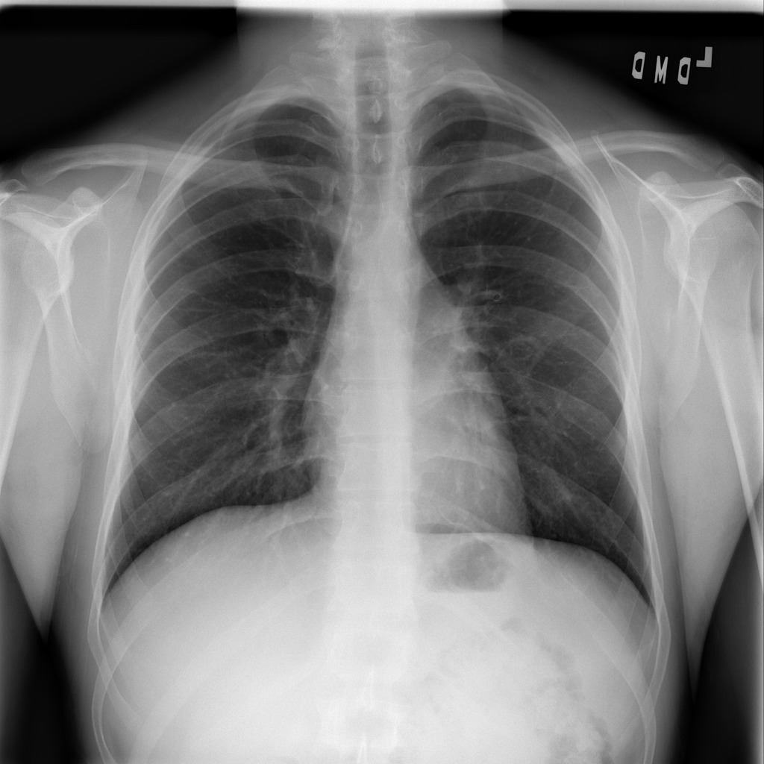
The Dataset
Pneumonia
COVID
Normal

Slide 12
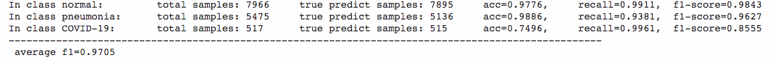
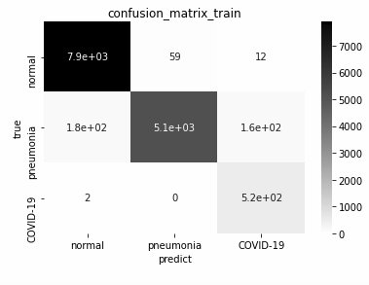
Training Results after stage 2
515 out of 517 samples of COVID-19 marked correctly by the network
F1 score of 0.9705 As you can notice recall as well as precision are considerably large

Slide 13
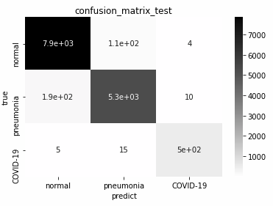
Training Results after stage 3
497 out of 517 samples of COVID-19 marked correctly by the network
F1 score of 0.9759 As you can notice recall as well as precision are considerably large

Slide 14
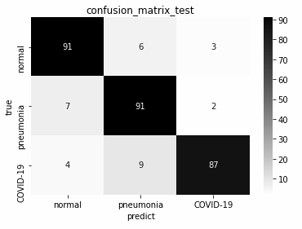
Test Results after stage 2
87 out of 100 samples of COVID-19 marked correctly by the network
F1 score of 0.8967 As you can notice recall as well as precision are considerably large

Slide 15
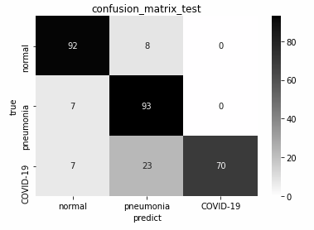
Test Results after stage 3
70 out of 100 samples of COVID-19 marked correctly by the network
Precision of 1 on covid-19 images Indicating all those images which are predicted covid-19 by our model are correct
F1 score of 0.85 As you can notice recall as well as precision are considerably large

Slide 16
Observations
The Precision of covid-19 images after stage 3 is greater than after stage 2 indicating that if we need higher Precision.
The F1 score and recall after stage 2 testing are better than after stage 3 indicating that if we need higher recall or in general better model, we should take the model after stage 2

Slide 17
How to run our model on custom dataset
First, run preprocessing.ipynb to convert the image dataset to NumPy arrays. Colab file(Preprocessing_colab)
Now either (if you have sufficient RAM) directly run GNR-Project.ipynb
Colab file (GNR_projectcolab)
If you don’t have enough RAM, run
CRL.ipynb
Stage1.ipynb Colab file (STAGE1_colab)
Stage2.ipynb Colab file (STAGE2_colab)
Stage3.ipynb Colab file (STAGE3_colab)

Slide 18
Miscellaneous
Data Augmentation
Medical data is very sensitive data. We did not want to use DA for Medical data.
Cyclic learning
Marginal increase in the accuracy
Use of discriminative learning rates
Marginal increase in the accuracy
We used constant learning rates which are the average of the learning rates given in the paper.

Slide 19
Citations
https://github.com/amaiya/ktrain
https://github.com/busyyang/COVID-19
https://github.com/lindawangg/COVID-Net/blob/master/docs/COVIDx.md
https://www.machinecurve.com/index.php/2020/02/25/training-your-neural-network-with-cyclical-learning-rates/
https://github.com/lindawangg/COVID-Net
https://arxiv.org/abs/2003.09871

Slide 20
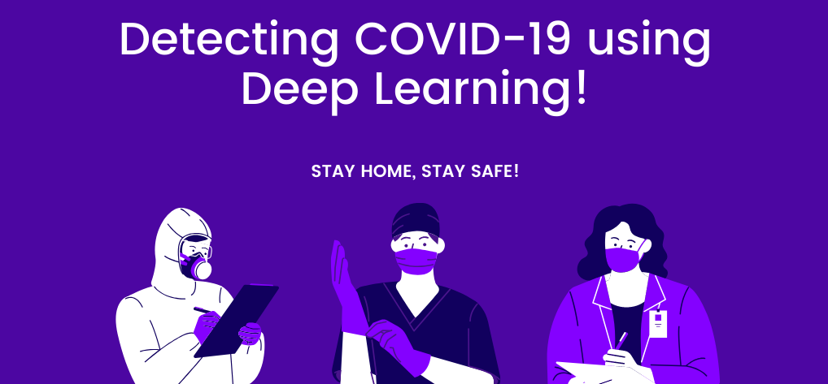
https://medium.com/@dakshtrehan

